Slide 1

requireJS zero basic course
Teacher： Guo Meng Tao

Slide 2
What is requireJS
require [rɪˈkwaɪr] verb
RequireJS is a JavaScript file and module loader
Author : James Burke ->before work at Mozilla(javascrpit)
Website ： www.requirejs.org

Slide 3
requireJS history
require [rɪˈkwaɪr] vt.
history：Who？When？Why ？
answer： James Burke Founded in 2009-9 atMozilla(javascrpit) working
requireJS name：old name runJS ,still in github

Slide 4
The exciting Requirejs to started
Step: 1. Download /CDN 2. file 3. Use requirejs 4. Use main.JS
Learn and find: requirejs File Loading Process
Learning: data - *** is an attribute of HTML

Slide 5
requirejs good points
Test：Use and No Use requirejs to find the good points
Good points 1：Not stop the webpage loading
Good points 2：Modular management of JS files

Slide 6
Two Ways of Use Requirejs
1. use data-main
2. In file
CDN：could use CDN to loading Requirejs

Slide 7
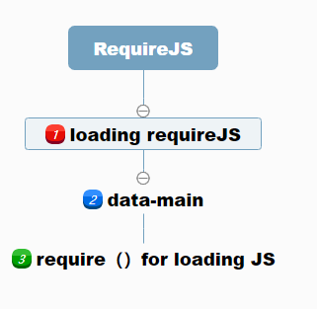
Use require () method to load JS
Use require () method to load modules
require (deps[,callback])
(diluted earnings per share)

Slide 8
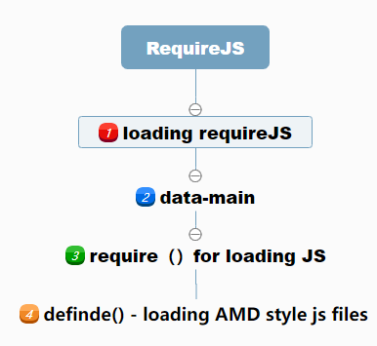
Define () AMD-style JS module
Define () AMD-style JS module
define(deps[,callback])
(diluted earnings per share)

Slide 9
Requirejs Write it once
Step: 1.use requirejs 2.data-main 3. require 4 define
require (deps[,callback]) define([deps,callback])
Learning: data - *** is an attribute of HTML

Slide 10
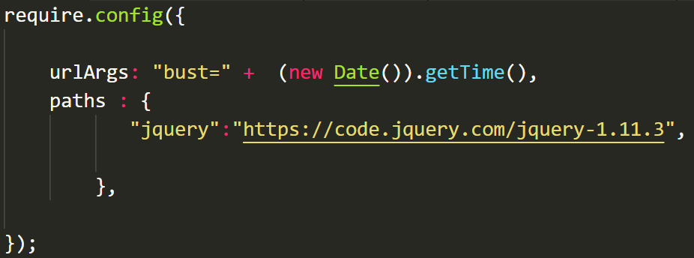
Requre.config method load config
作用：两个都一样用，为了便于书写用$比较短
对比自己写的tom.js库提现这种作用
示例: $(“h1”).hide() 作用等于 jQuery(“h1").hide()

Slide 11
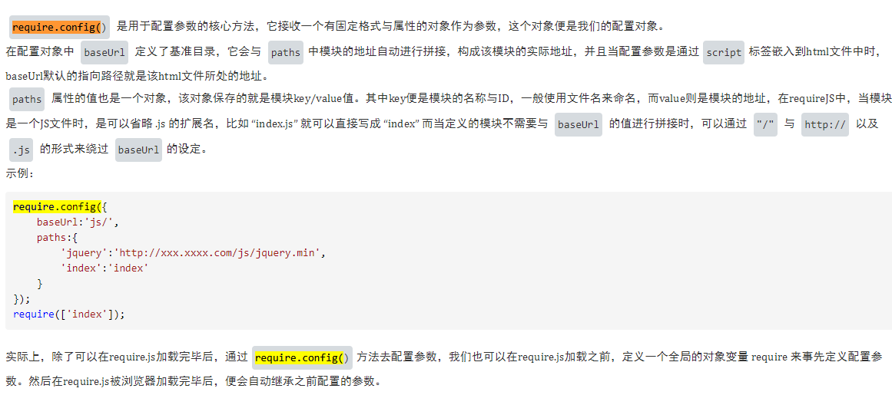
初始require.config配置参数核心方法
作用：两个都一样用，为了便于书写用$比较短
对比自己写的tom.js库提现这种作用
示例: $(“h1”).hide() 作用等于 jQuery(“h1").hide()

Slide 12
important paths option
Read requirejs API， use CDN
starts with a “/” , do not add the .js
Only floder ok

Slide 13
waitSeconds and callback options
waitSeconds ：wait before giving up on loading a script
callback ：after deps have been loaded
scriptType： value for the type=“”Default is "text/javascript"

Slide 14
Shim for loading JS in non-AMD format
1. A new way to declare JS dependencies
2. non-AMD format js for loading

Slide 15
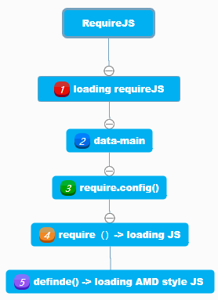
Requirejs Introduction summary
History/Founder
Download
Data-main
configuration
Call module
Amd format

